Slide 1
K.K.ENTERPRISE
Manufacturers & Exporters of Steel & Stainless Steel Forgings with Grey and Ductile Iron Fully Finished Components
WELCOME
Unit Address: K.K.ENTERPRISE
Plot no. 199/3 , road - m,
Aji GIDC industrial area.,
Near balaji wafers,
Dist.: Rajkot – 360 002.
Gujarat-India.
Contact No.: 9712763990
Email :k.k.enterprise460@gmail.com
Website:www.k.k.enterpriseindia.com

Slide 2
K.K.ENTERPRISE established in the year 2013 with well qualified and vastly experienced team members. It is customer focused organization and now well known manufacture and supply of Closed Die Steel Forging, Upset Forging, Ring Rolling Forging & From 1980 we are in Casting Facility in all commodities CI , SG Iron ,SS , Aluminum and Steel Casting Duly Finish Machined Components for domestic & International requirement.
M/s K.K.ENTERPRISE, considered as one of the best manufacturing group having in-house advanced technologies to develop and manufacture various engineering components with highest quality, functionality and cost effectiveness.
Company Profile

Slide 3
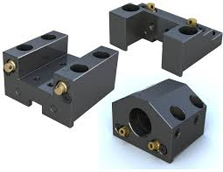
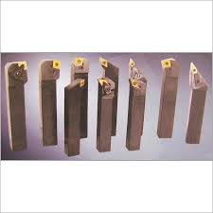
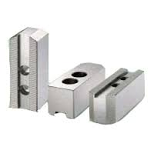
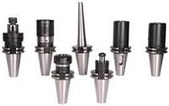
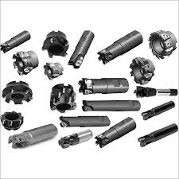
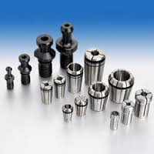
Now , K.K.ENTERPRISE start to manufacture work holding devices , Jaws , CNC , VMC , HMC tool holders , collets , VMC centers with superior quality.
Company Profile

Slide 4
Manufacturing Activities: 1.) Closed Die Forgings
2.) Upset Forging 3.) Ring Rolling
4.) Precision Machining
Establishment Year : 1980 & 2013
Quality Certification: 1.) ISO: 9001:2008
Forging Production : 3000 MT / Annum Installed
Capacity 1750 MT / Annum Current Production
Casting Production : 300 Ton Monthly - Capacity CI and SG IRON
STEEL Casting Production : 150 Ton Monthly
Investment Casting Production : 100 Ton Monthly – S.S.
Pressure Die Casting Production : 125 Ton Monthly – Aluminum
Details of Company

Slide 5
Details of Company
Total staff strength is about 85, including :
Managers
Engineers
Administrative staff
Skilled Workers
Semi Skilled Workers

Slide 6
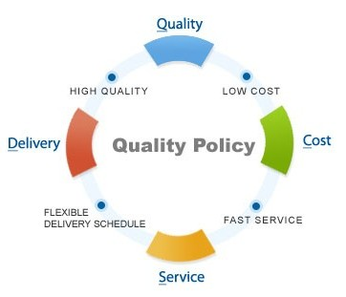
Quality Policy
We K.K.ENTERPRISE are committed to supply Quality Product & on Time Complaint Free Delivery to Get Complete Customer Satisfaction through continual improvement.

Slide 7
Quality Objective
To Achieve Customer Satisfaction .
To Provide In Time Delivery.
Consistently reduce rejection, rework and process variation.
To Minimize customer Complaints.
To increase product delivery rating.
To increase Sales.

Slide 8
Equipment List
Forging Shop
Line 1 : Belt Drop Hammer - 2.0MT
Electric Billet Heater - 250KW
Trimming Press- 200MT
Line 2 : Belt Drop Hammer – 1.00 MT
Electric Billet Heater - 180KW
Trimming Press- 100MT
Line 3: Belt Drop Hammer 0.75MT
Electric Billet Heater - 80KW
Trimming Press- 75MT
Line 4: Screw Press - 200 MT
Electric Billet Heater - 80KW
Trimming Press- 50MT

Slide 9
Equipment List
Die Shop & Machine Shop
CNC & VMC Machines
VMC Machine – 5 Axis
Broaching Machines (vertical and horizontal)
Lathe Machines
Spark Erosion Die Sinking
Shaping Machine
Milling Machine
Tool & cutter grinders
Dot Pin Marking Machine

Slide 10
Equipment List
Testing & Inspection
CMM (Coordinate Measuring Machine) – Near by location
Contour Measurement – Near by location - Near by location
Magnetic / Ultrasonic test for Crack Detection
Surface Roughness Testing
Hardness Testing (Rockwell & Brinell)
Dial Gauges, Micrometers & Vernier etc.
Impact Testing Machine
Universal testing Machine
Jominy End Quench Testing Machine
Chemical Composition for Casting
Sand Testing Facility (out sourced and shortly will be in-house)

Slide 11
Technical Capabilities- Weight
Forging
Weight per Piece : 0.1 Kg to 35 Kgs
Round Forging : Ring Outer Dia. Up to 400 mm & 100.00 mm Thickness
Profile Job Forging : 0.1 Kg to 20.0 Kgs
Casting
Weight per Piece : 200 Kgs
CI and SG-IRON
Weight per Piece : 350 Kgs - Steel Casting (Sand)

Slide 12
Industries we are serving
Automobiles
Industrial Valves & Pumps
Boiler & Turbine Parts
Marine
Earth Moving Equipment
Hardware & Power Transmission

Slide 13
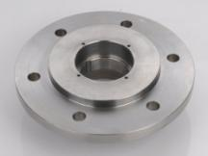
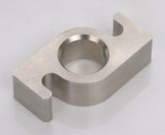
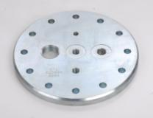
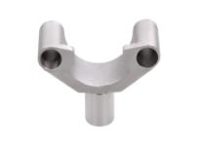
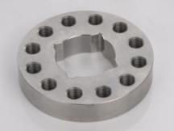
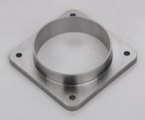
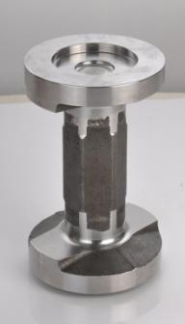
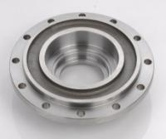
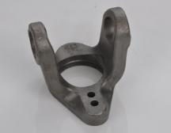
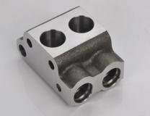
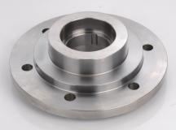
Product Range

Slide 14
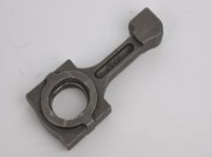
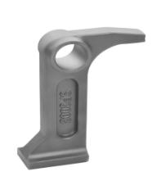
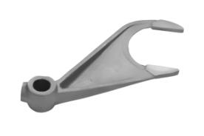
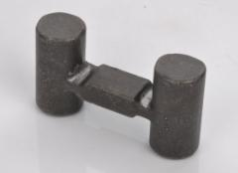
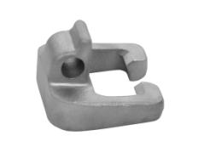
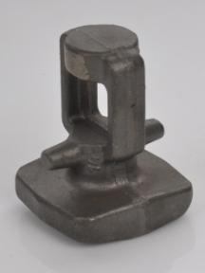
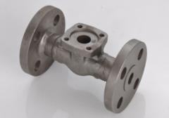
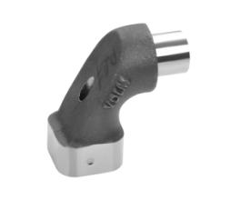
Product Range

Slide 15
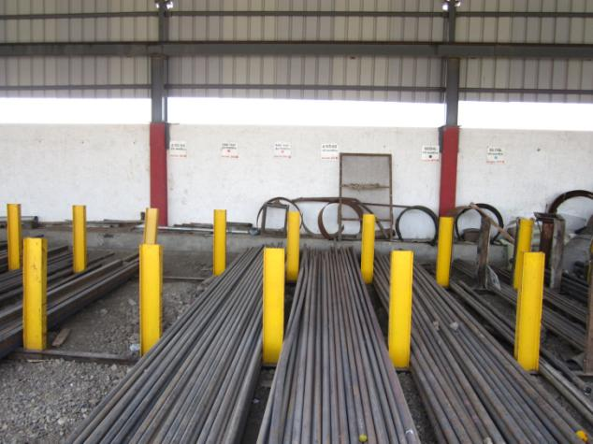
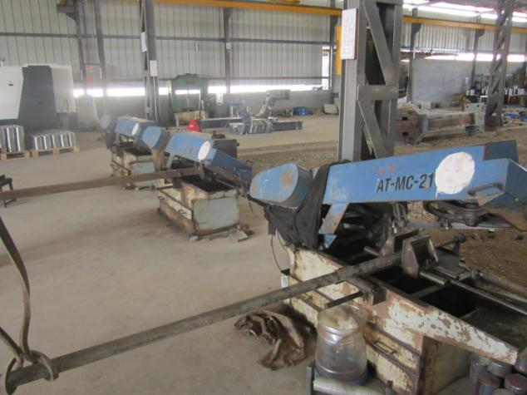
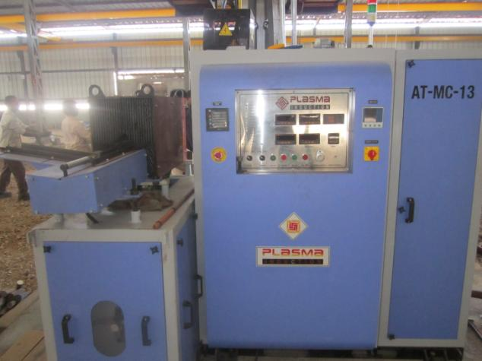
Plant Overview

Slide 16
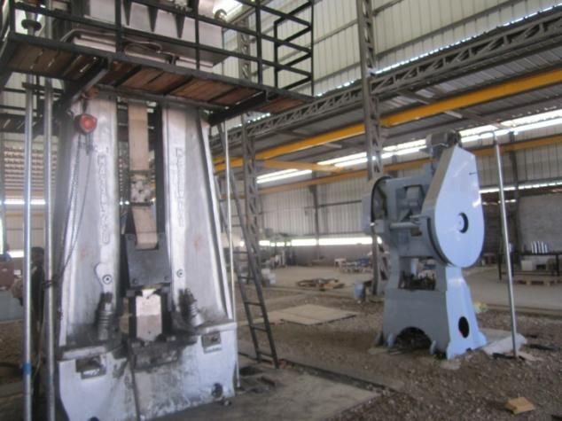
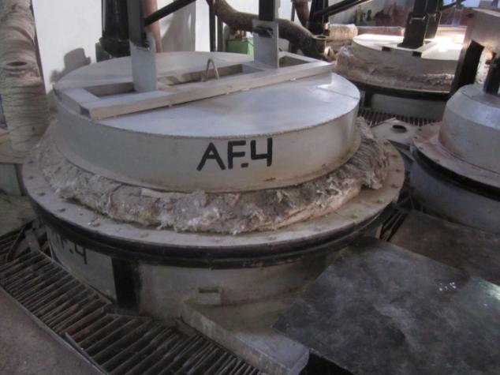
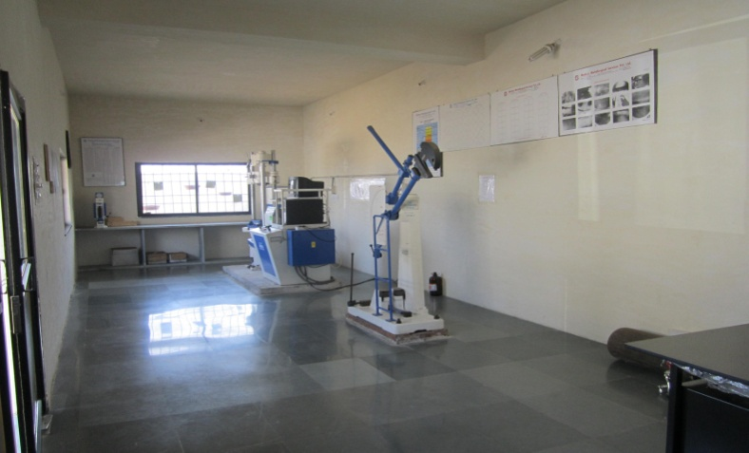
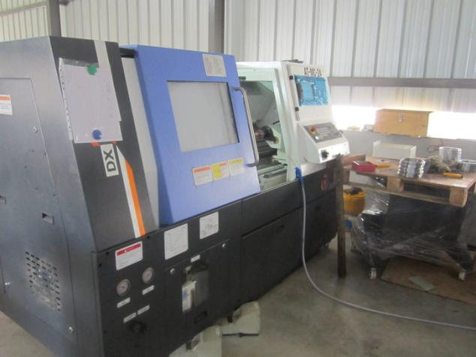
Plant Overview

Slide 17
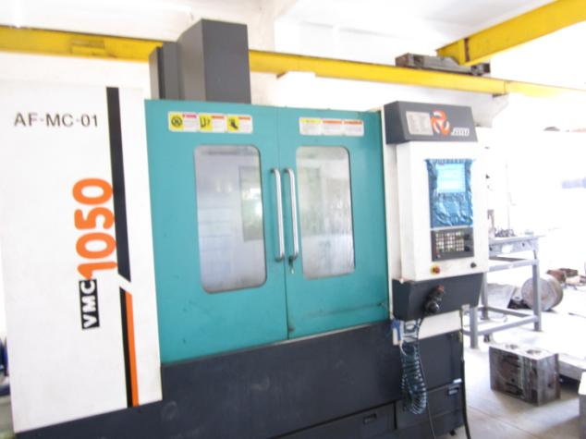
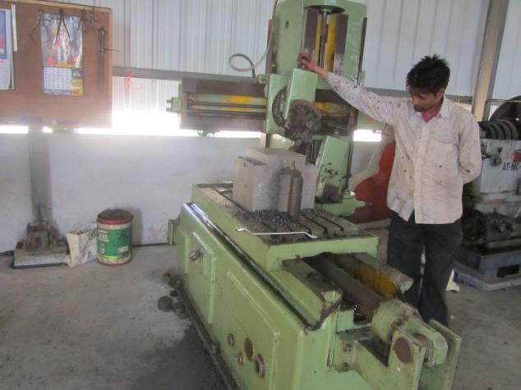
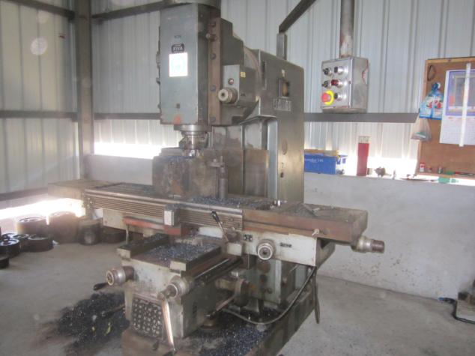
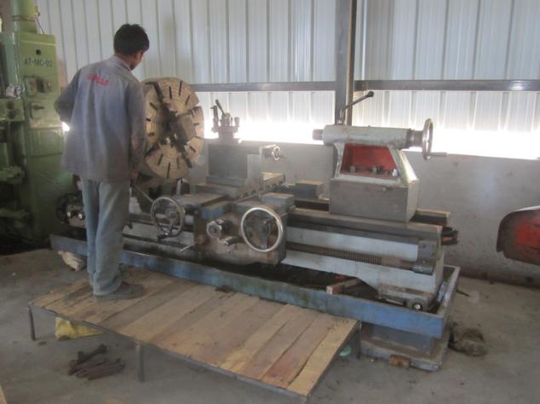
Plant Overview

Slide 18
Turn Over (In lacs)

Slide 19
Segment Wise Sales Year-14-15

Slide 20
Productivity (MT/Per)

